Slide 1
Pruning文献报告
陈进泽

Slide 2
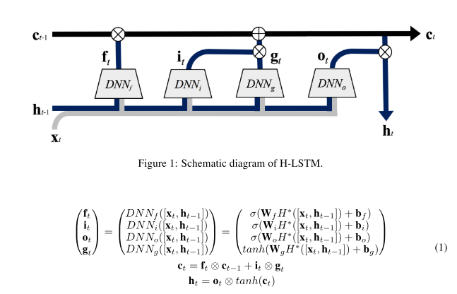
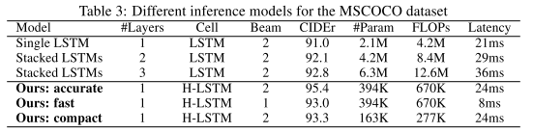
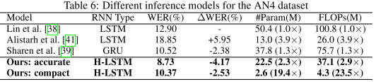


Grow and Prune Compact, Fast, and Accurate LSTMs
Hidden-Layer LSTM
  Strengthened control
  Easy regularization
  Flexible gates
Grow & Pruning Training
  Growth policy: Activate a dormant w in W iff |w.grad| is larger than the (100α)th percentile of all elements in |W.grad|.
  Pruning policy: Remove a w iff |w| is smaller than the (100β)th percentile of all elements in |W|.
Results
NeuralTalk for Image Captioning
DeepSpeech2 for Speech Recognition

Slide 3
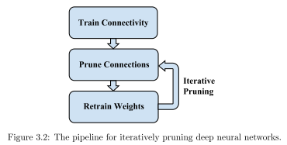
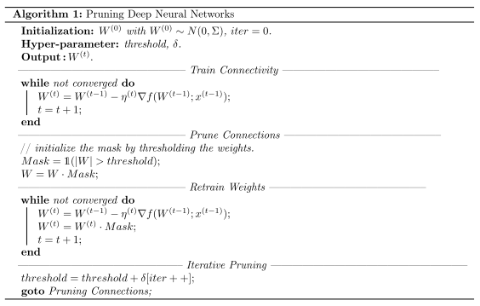
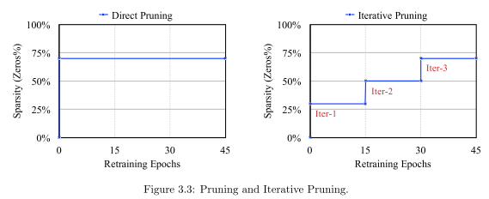
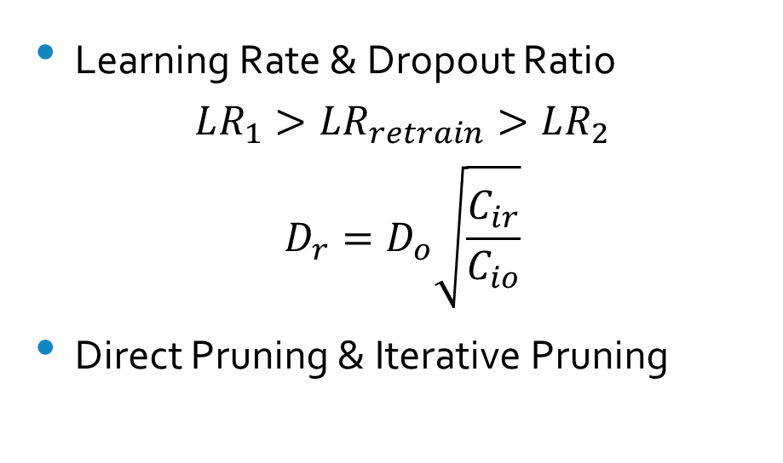
EFFICIENT METHODS AND HARDWARE FOR DEEP LEARNING(125p)
Pruning Methodology
pseudocode
Learning Rate & Dropout Ratio
$$LR_{1}>LR_{retrain}>LR_{2}$$
$$D_{r}=D_{o}\sqrt{\frac{C_{ir}}{C_{io}}}$$
Direct Pruning & Iterative Pruning

Slide 4
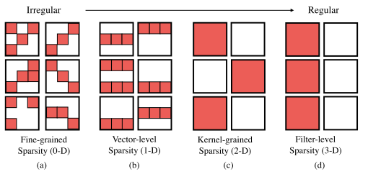
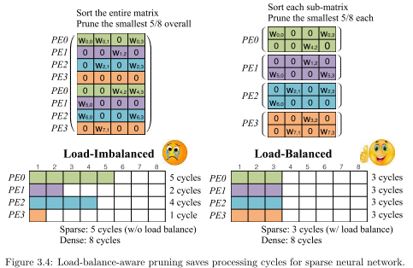
Different Pruning Granularities
Load Balance (parallel processing)
Hardware Efficiency Considerations

Slide 5
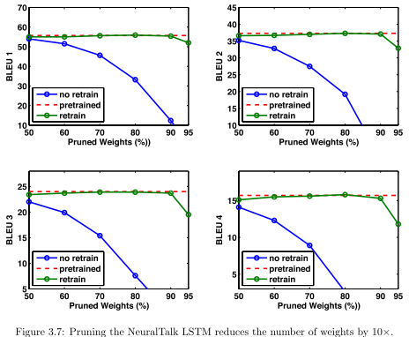
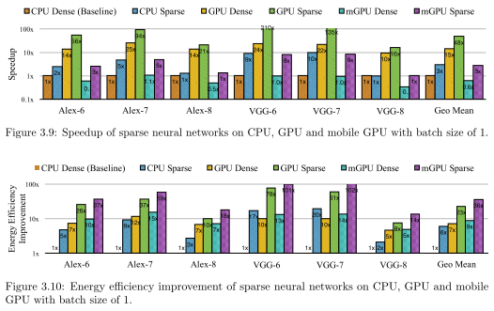
Results
  MNIST: connections by 12x, computation by 12x
  RNNs & LSTMs
  Speedup and Energy Efficiency

Slide 6
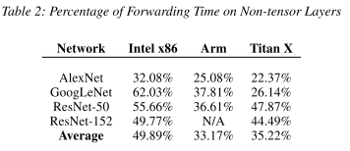
DeepRebirth: Accelerating Deep Neural Network Execution on Mobile Devices
Fundamentals
  Non-tensor layers consume too much time in model
  Non-tensor layers can be combined into tensor layers
Methodologies
  Streamline Slimming
  Branch Slimming

Slide 7
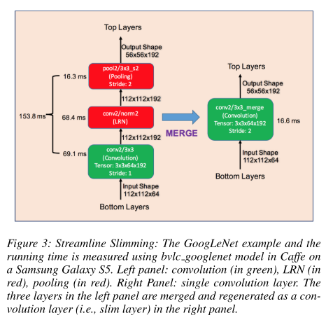
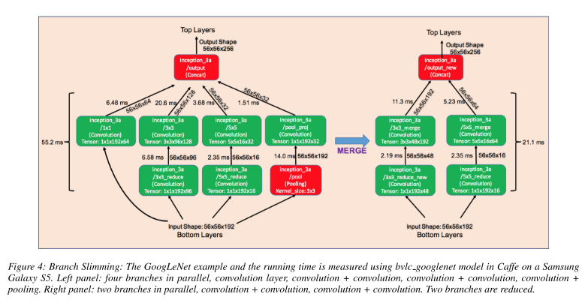
Streamline Slimming
Branch Slimming
Retrain the network to obtain the best performance

Slide 8
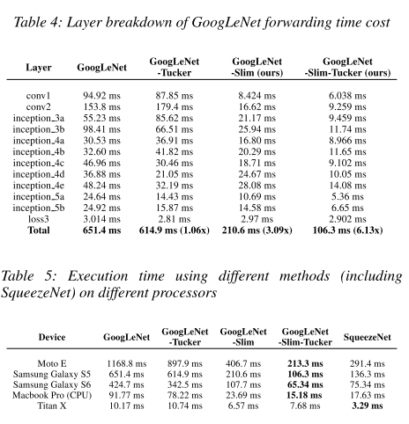
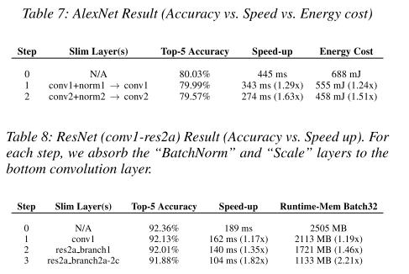
Evaluation

Slide 9
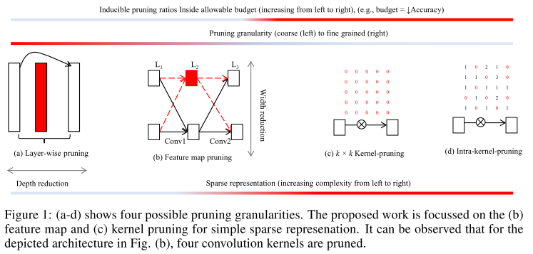
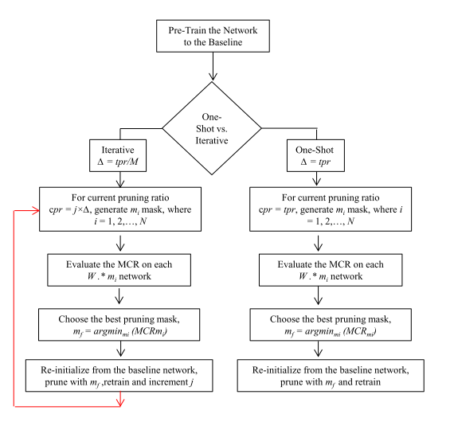
COARSE PRUNING OF CONVOLUTIONAL NEURAL NETWORKS WITH RANDOM MASKS(CNN)
Different Pruning Granularities
Retrain procedure

Slide 10
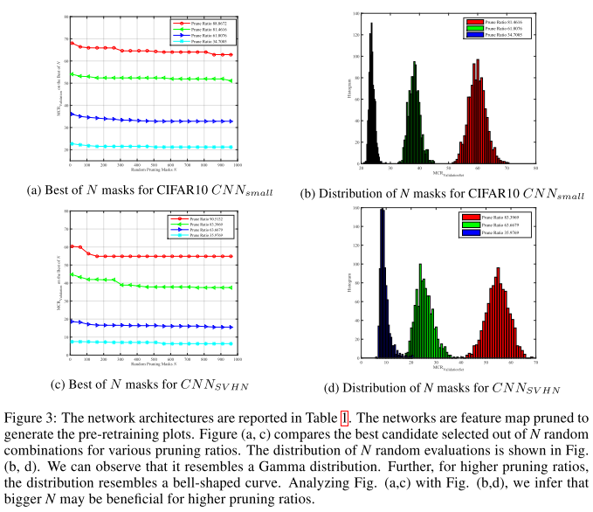
PRUNING CANDIDATE SELECTION
Randomly generate N pruning masks and compute the misclassification rate (MCR) for each one.
N can be estimated initially and later used in several pruning passes.
FEATURE MAP AND KERNEL PRUNING
Pruning a feature map eliminates all the incoming and outgoing kernels because the outgoing kernels are no more meaningful.
*The true benefit of kernel pruning can be obtained with FFT based masked convolution.

Slide 11
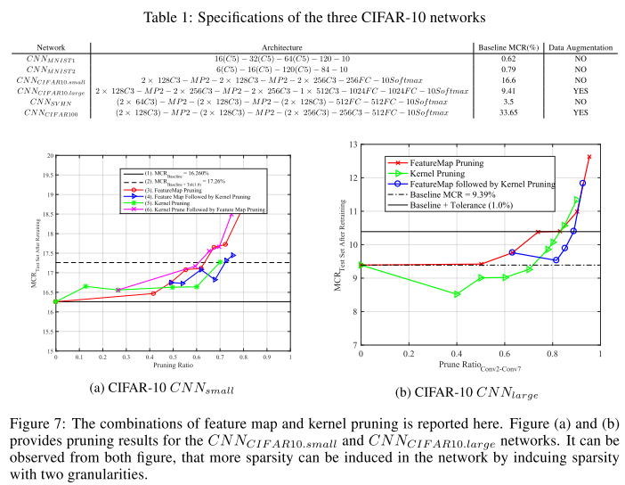
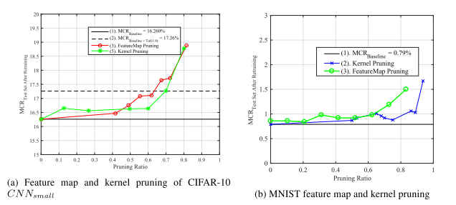
Evaluation
Benefit: In memory cost & computation

Slide 12
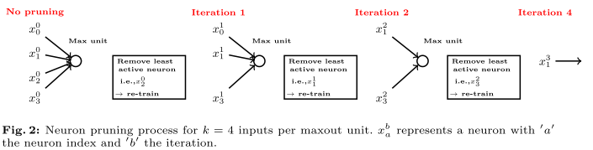
Neuron Pruning for Compressing Deep Networks using Maxout Architectures (GCPR)
Fundamentals
  Redundancies exist in maxout units.
  The maximum of several neurons is able to approximate a more complex neuron.
Methodology
  Neuron Pruning
    A CNN with a maxout layer is trained
    The least active neurons of each maxout unit are removed from the network
    The remaining neurons of the CNN are re-trained. After re-training, the process is repeated
  Weight Pruning
    Set Threshold
    Weights below this threshold are deleted
    The network is re-trained
[1] Moya Rueda, Fernando & Grzeszick, Rene & A. Fink, Gernot. (2017). Neuron Pruning for Compressing Deep Networks Using Maxout Architectures. 177-188. 10.1007/978-3-319-66709-6_15.

Slide 13
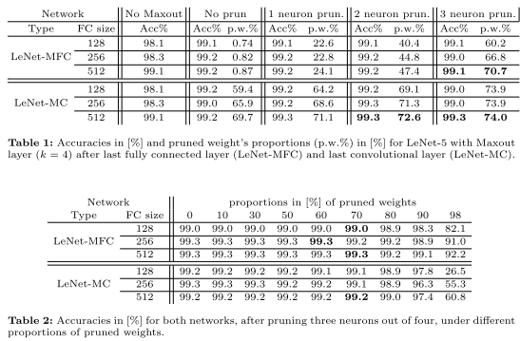
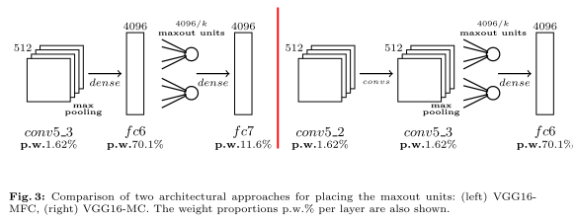
Evaluation
Results
  The performance of this reduction approach depends strongly on the position of the maxout layer in the network.
  The proposed approach allows to reduce a network’s size by 61−74% on an architectural level and without affecting the network’s performance.
[1] Moya Rueda, Fernando & Grzeszick, Rene & A. Fink, Gernot. (2017). Neuron Pruning for Compressing Deep Networks Using Maxout Architectures. 177-188. 10.1007/978-3-319-66709-6_15.

Slide 14
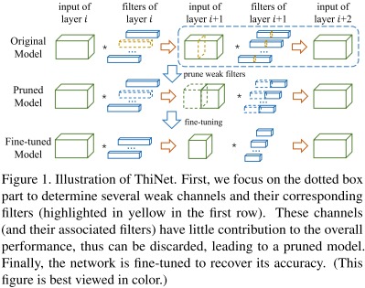



ThiNet: A Filter Level Pruning Method for Deep Neural Network Compression
Fundamentals
  The performance of non-structured pruning is limited
  Whether a filter can be pruned depends on the outputs of its next layer, not its own layer.
Methodology
  Filter selection: Using a subset of channels in layer (i + 1)’s input to approximate the output in layer i + 1
  Pruning: Weak channels in layer (i + 1)’s input and their corresponding filters in layer i would be pruned away,
  Fine-tuning
  Iterate to step 1 to prune the next layer
Principle
[2] Luo, Jian-Hao & Wu, Jianxin & Lin, Weiyao. (2017). ThiNet: A Filter Level Pruning Method for Deep Neural Network Compression. 5068-5076. 10.1109/ICCV.2017.541.

Slide 15
ThiNet: A Filter Level Pruning Method for Deep Neural Network Compression
Fundamentals
  The performance of non-structured pruning is limited
  Whether a filter can be pruned depends on the outputs of its next layer, not its own layer.
Methodology
  Filter selection: Using a subset of channels in layer (i + 1)’s input to approximate the output in layer i + 1
  Pruning: Weak channels in layer (i + 1)’s input and their corresponding filters in layer i would be pruned away,
  Fine-tuning
  Iterate to step 1 to prune the next layer
Principle
[2] Luo, Jian-Hao & Wu, Jianxin & Lin, Weiyao. (2017). ThiNet: A Filter Level Pruning Method for Deep Neural Network Compression. 5068-5076. 10.1109/ICCV.2017.541.

Slide 16
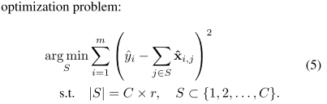

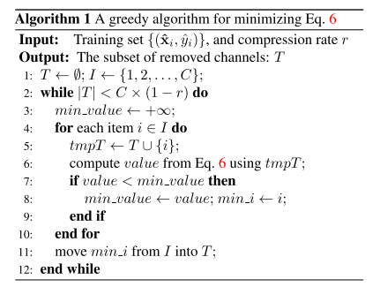
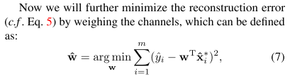
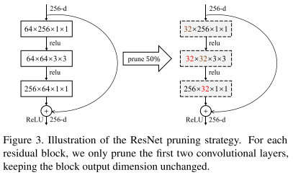
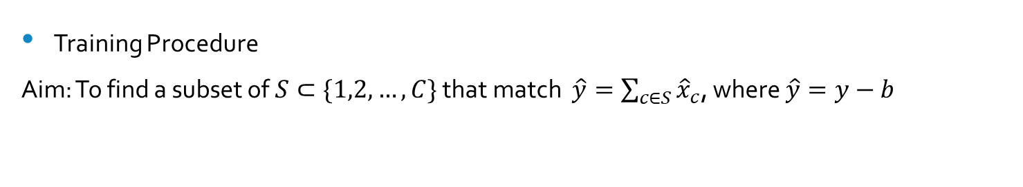
Training Procedure
Aim: To find a subset of $S⊂\{1,2,…,C\}$ that match $\hat{y}=\sum_{c∈S}{{\hat{x}}_{c}}$, where $\hat{y}=y−b$
Or
A greedy algorithm for channel selection
Minimize the reconstruction error
Pruning strategy
[2] Luo, Jian-Hao & Wu, Jianxin & Lin, Weiyao. (2017). ThiNet: A Filter Level Pruning Method for Deep Neural Network Compression. 5068-5076. 10.1109/ICCV.2017.541.

Slide 17
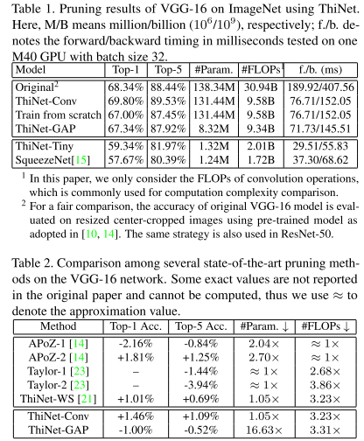
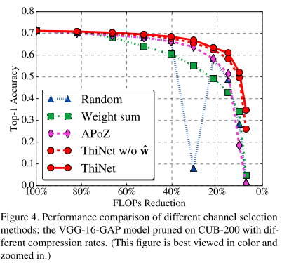
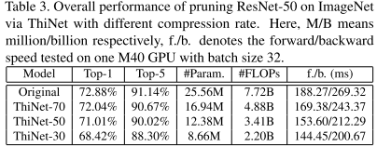
Evaluation
VGG-16 on ImageNet
Different filter selection criteria
VGG-16 on ImageNet
[2] Luo, Jian-Hao & Wu, Jianxin & Lin, Weiyao. (2017). ThiNet: A Filter Level Pruning Method for Deep Neural Network Compression. 5068-5076. 10.1109/ICCV.2017.541.

Slide 18
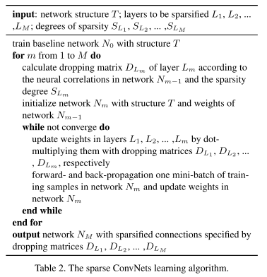
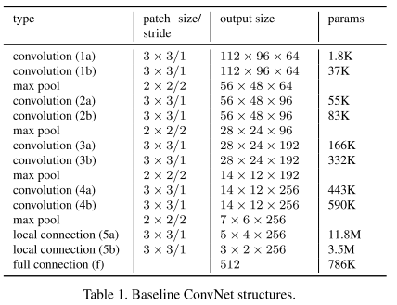
Sparsifying Neural Network Connections for Face Recognition
Fundamentals
  The correlation between two connected neurons are defined by the magnitude of the correlation between their neural activations.
Methodology
  Baseline model
  Sparse ConvNets
[3] Sun, Yi & Wang, Xiaogang & Tang, Xiaoou. (2016). Sparsifying Neural Network Connections for Face Recognition. 4856-4864. 10.1109/CVPR.2016.525.

Slide 19
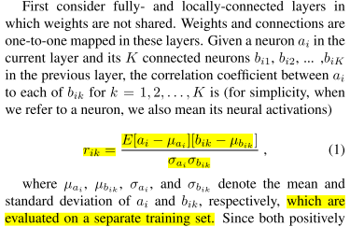
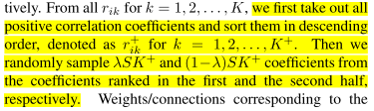
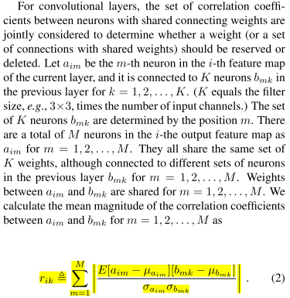

Sparsify connections
[3] Sun, Yi & Wang, Xiaogang & Tang, Xiaoou. (2016). Sparsifying Neural Network Connections for Face Recognition. 4856-4864. 10.1109/CVPR.2016.525.

Slide 20
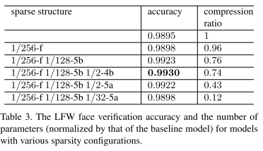
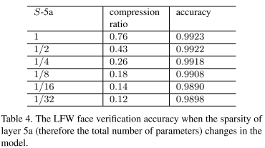
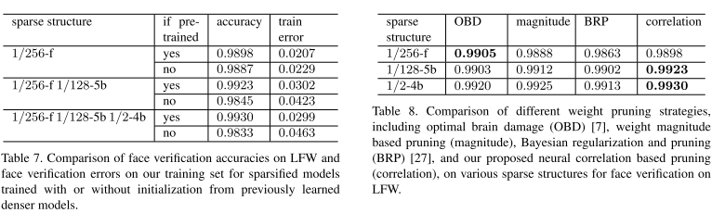
Evaluation
[3] Sun, Yi & Wang, Xiaogang & Tang, Xiaoou. (2016). Sparsifying Neural Network Connections for Face Recognition. 4856-4864. 10.1109/CVPR.2016.525.

Slide 21
Summary
Pruning criterion
  Second derivative related criterion. “Optimal Brain Damage.”
  Weights with small means and large variances are pruned. <- weights treated as Gaussian random variables
  Absolute weight sum. Single Layer
  Measure the sparsity of activations after the ReLU function. <- the number of zero outputs Single Layer
  Taylor expansion to approximate the influence to loss function induced by removing each filter.
  Absolute weight (Song Han) Single Layer
  Correlation
  Random path loss
Pruning granularity
  Layer-wise pruning
  Feature map pruning
  Kernel-pruning
  Intra-kernel-pruning
Retraining procedure
  Iteratively
  One-shot
When to stop
  Training converges (seldom)
  Achieve the desired pruning ratio
  After specific epochs

Slide 22
Summary
Some interesting notes
  Sparsity improves performance <- “Sparsifying Neural Network Connections for Face Recognition”
  Directly training the sparse ConvNet from scratch failed to find good solutions for face recognition, while using a previously learned denser model to properly initialize a sparser model is critical to continue learning effective features for face recognition.
  keeping a small portion of connections to weakly correlated neurons is also helpful.
  Better pruning results can be achieved when a network is pruned with both granularities successively. <- “COARSE PRUNING OF CONVOLUTIONAL NEURAL NETWORKS WITH RANDOM MASKS”
  Pre-retraining least adversarial pruning masks perform better after retraining
  The number of neuron synapses has reached the peak in early childhood, followed by gradual pruning during its development. <- “ThiNet: A Filter Level Pruning Method for Deep Neural Network Compression”
  Neurons only get pruned at a very high compression ratio <- “Neuron Pruning for Compressing Deep Networks using Maxout Architectures”
  Probabilistically pruning parameters based on their absolute value gave worse results with respect to accuracy <- “EFFICIENT METHODS AND HARDWARE FOR DEEP LEARNING”
  Accuracy doesn’t drop sharply until about 70% the pruning ratio and less as pruning becomes coarser

Slide 23
Bibliography
Dai, Xiaoliang & Yin, Hongxu & Jha, N.K.. (2018). Grow and Prune Compact, Fast, and Accurate LSTMs.
Dally, Bill. (2017). Efficient methods and hardware for deep learning. 1. 10.1145/3149166.3149168.
Li, Dawei & Wang, Xiaolong & Kong, Deguang. (2017). DeepRebirth: Accelerating Deep Neural Network Execution on Mobile Devices.
Coarse Pruning of Convolutional Neural Networks with Random Masks (ICLR2017 rejected)
[1] Moya Rueda, Fernando & Grzeszick, Rene & A. Fink, Gernot. (2017). Neuron Pruning for Compressing Deep Networks Using Maxout Architectures. 177-188. 10.1007/978-3-319-66709-6_15.
[2] Luo, Jian-Hao & Wu, Jianxin & Lin, Weiyao. (2017). ThiNet: A Filter Level Pruning Method for Deep Neural Network Compression. 5068-5076. 10.1109/ICCV.2017.541.
[3] Sun, Yi & Wang, Xiaogang & Tang, Xiaoou. (2016). Sparsifying Neural Network Connections for Face Recognition. 4856-4864. 10.1109/CVPR.2016.525.

Slide 24
Source Code
Soft Filter Pruning for Accelerating Deep Convolutional Neural Networks
ThiNet: A Filter Level Pruning Method for Deep Neural Network Compression
Pruning Convolutional Neural Networks for Resource Efficient Inference
Dynamic Network Surgery for Efficient DNNs
Learning both Weights and Connections for Efficient Neural Networks -- /d DeepCompression-PyTorch
Deep Compression: Compressing Deep Neural Networks with Pruning, Trained Quantization and Huffman Coding -- /d DeepCompression-caffe
Channel Pruning for Accelerating Very Deep Neural Networks

